Slide 1
Optimus Octavian
Volvo CoPilot Safe Assist
November 20, 2017

Slide 2
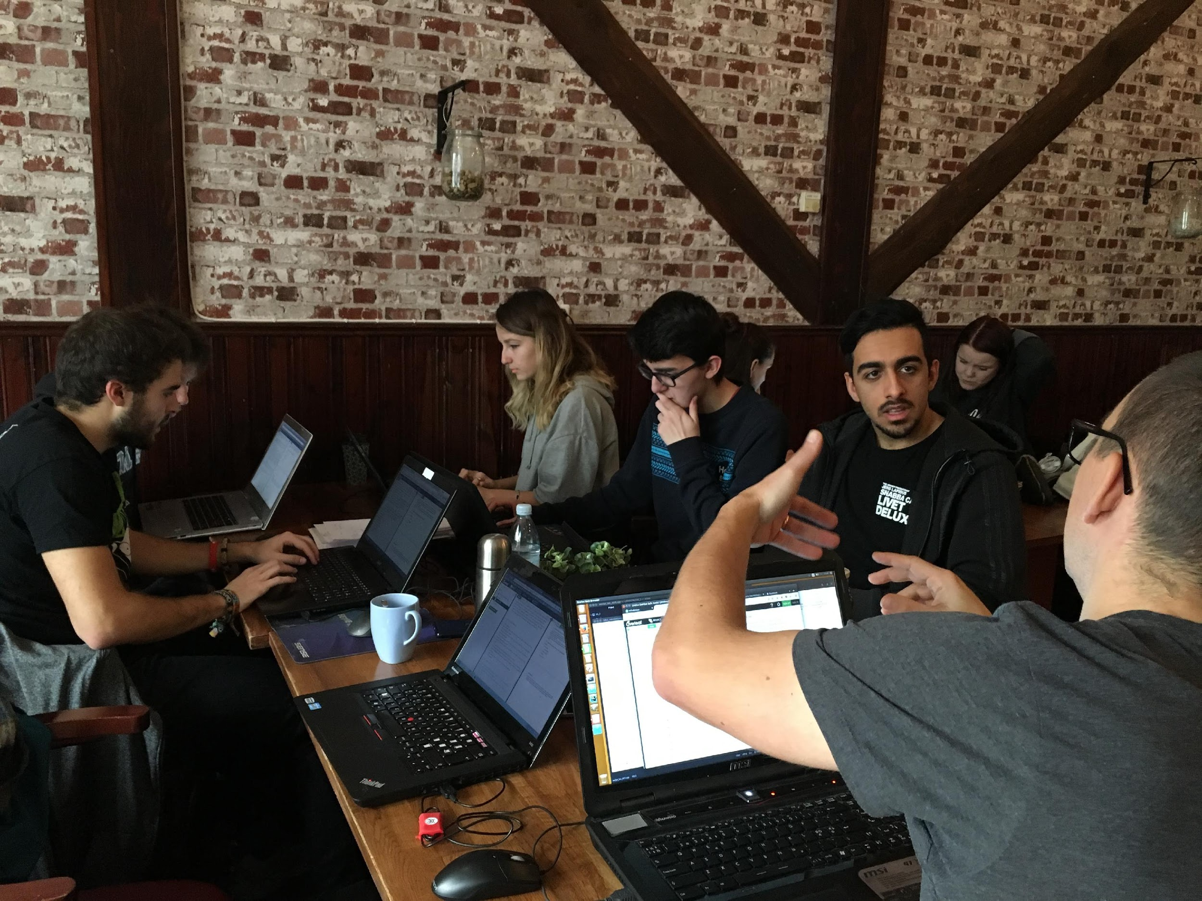
AN OTHER TEAM MEETING

Slide 3
AN OTHER TEAM MEETING
Finish the Project plan
Research Android features for the app

Slide 4
TUTORIAL DAY
Android
GitHub Desktop
Bluetooth Explanation
Set the tasks to be done for the next sprint
Low level design and core features to implement
Code standard

Slide 5
WORKED HOURS
An average of 16 hours per person (not counting minor tasks)

Slide 6
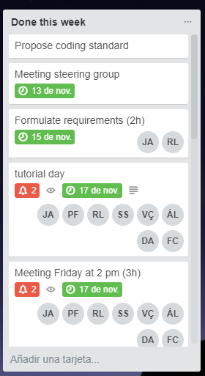
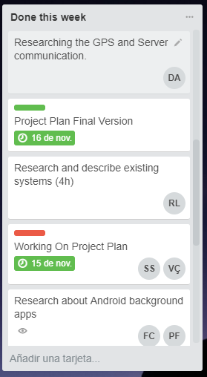
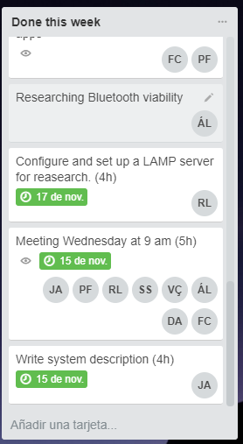
DONE THIS WEEK

Slide 7
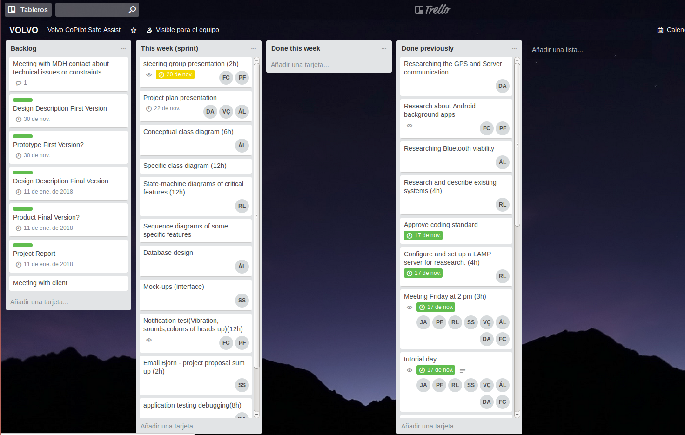
NEXT WEEK

Slide 8
THANKS!!

